Slide 1
Aortoarteritis:
Clinical approach and management
Dr. Jaganmohan A Tharakan
Professor of Cardiology
P K Das Institute of Medical Sciences, Palakkad, Kerala

Slide 2
Takayasu Arteritis : History
1830: Yamamoto described the case of a 45 year old man with persistent fever who developed impalpable upper limb and carotid pulses associated with weight loss and dyspnoea.
1905: Takayasu presented the case of a 21 year old woman with characteristic fundal arterio-venous anastomosis.
1905: Onishi and Kagoshima: described similar cases associated with absent radial pulses.
1920: First postmortem case of a 25 year old woman demonstrated pan-arteritis and suggested that the fundal appearances resulted from retinal ischaemia.
1951: Shimizu and Sano: summarized the clinical features of this “pulseless disease”.

Slide 3
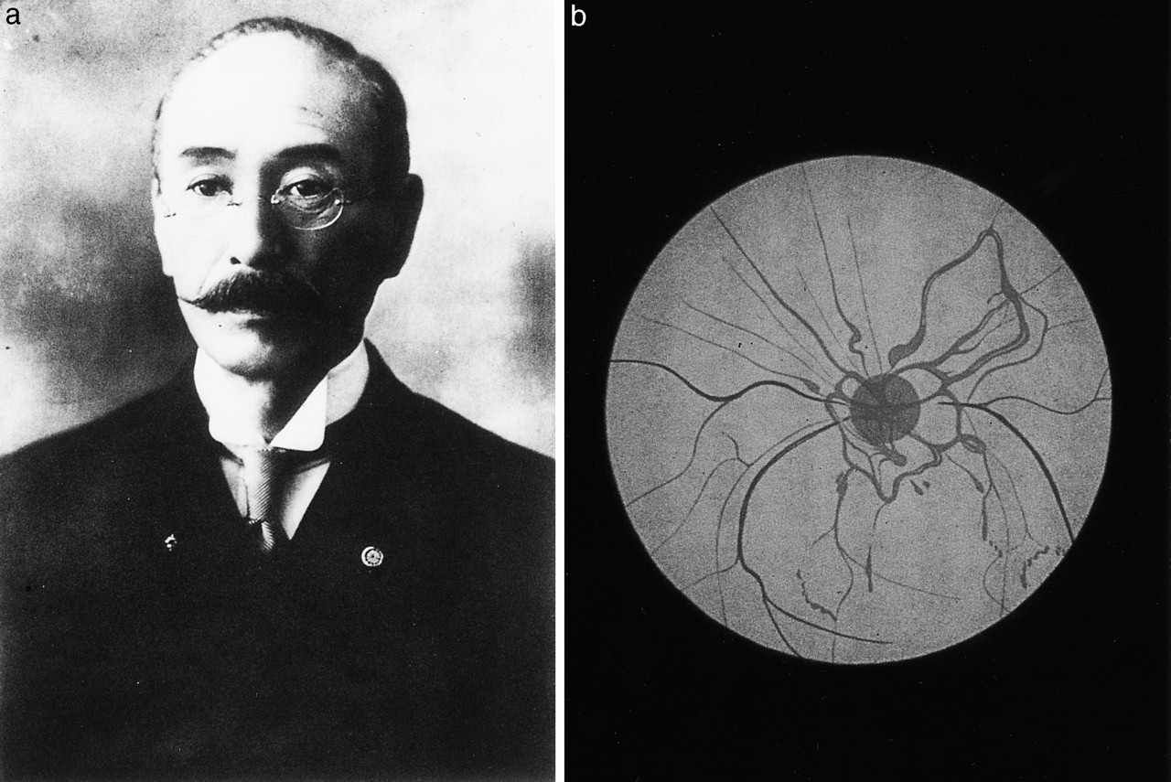
Japan Ophthalmology Society 1908
Katsutomo Onishi

Slide 4
Scope of discussion
Introduction
Etiology & pathogenesis
Clinical Manifestations & distribution of lesions
Diagnostic criteria
Disease activity and imaging
Medical Management
Interventions – Surgical and Percutaneous

Slide 5
Takayasu arteritis (TA)
Chronic, idiopathic, granulomatous, large vessel vasculitis, manifesting mainly as a pan-aortitis: affecting elastic arteries mainly aorta and its branches:
Arterial lesions:
    segmental stenosis → occlusion
    Dilatation → aneurysm formation.

Slide 6
Takayasu arteritis
Women >>> Men ( Western 80%, India 6.4 :1)
20 – 40 years of Age
Higher prevalence in Asia
Incidence:
  150 cases/million inhabitants /year (Asia) vs
  1 - 3 cases/million/year (Europe, America)

Slide 7
TA: Geographical difference
The Japanese patients (n = 80) : predominantly female (96%), presenting with dizziness, vertigo, pulselessness, and more aortic regurgitation, reflecting involvement of the aortic arch and its main branches.
Indian patients (n = 102) : 37% were male, tended to present with headache, hypertension, and left ventricular hypertrophy as a result of vasculitis affecting the abdominal aorta and renal vessels.
However, most patients in both countries had diffuse disease.

Slide 8
TA : pan arteritis
The initial site of inflammation is around the vasa vasora and at the medio-adventitial junction.
  Edema, and mononuclear cell infiltration (CD4 and CD8 lymphocytes, plasma cells, and macrophages)
Giant cell granulomatous reaction and necrosis may be present.
Fragmentation of elastic fibers prominent.
Loss of smooth muscle cells leads to medial weakening, vascular dilatation, and aneurysm formation.
Healing phase shows predominantly fibrosis in all layers

Slide 9
Pathology
Pan-arteritis
Non caseating granulomas
Vaso vasorum acts as the port of entry for the inflammatory infiltrate
Immunologic mechanisms intervene at a cellular level:
  Inflammation → Wall thickening → Fibrosis
  Stenosis → Occlusion (40%-50 %) → Thrombosis
  Aneurysmal dilation (5%)
In advanced critical stage, the aortic intima may have ‘tree-bark’ appearance similar to that of luetic aortitis.
Skipped areas of aortic involvement are quite characteristic of aortoarteritis

Slide 10
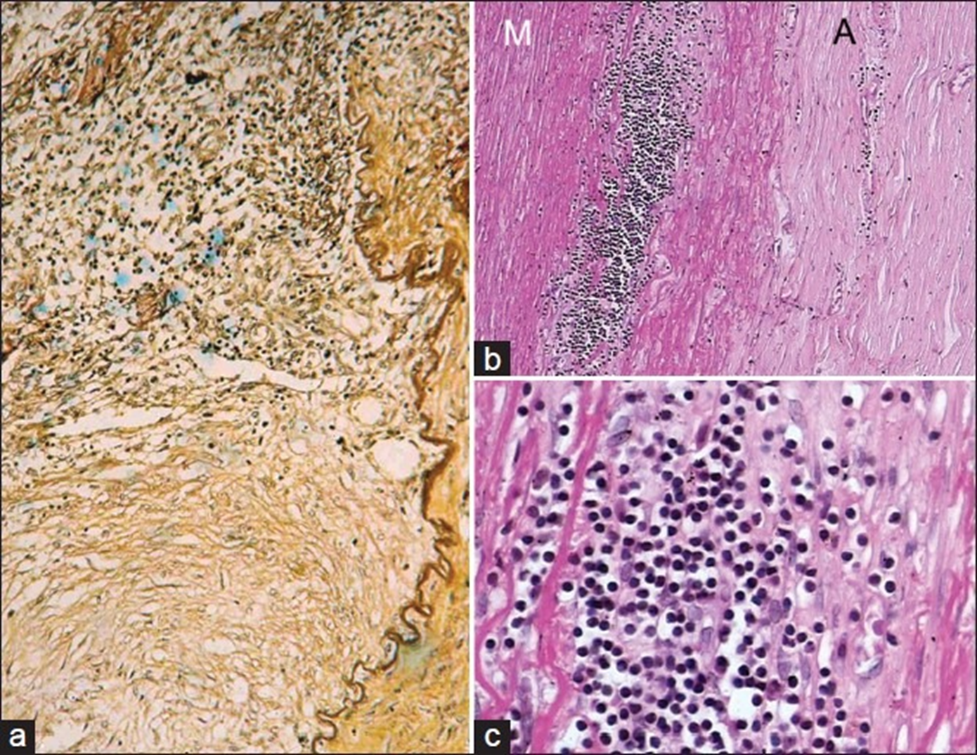
(b) chronic phase of TA in descending thoracic aorta showing media (M) at the outer third with clusters of mononuclear cells. Note marked fibrosis of the adventitia (A)
(c) The cells are lymphocytes, and few plasma cells and histiocytes

Slide 11
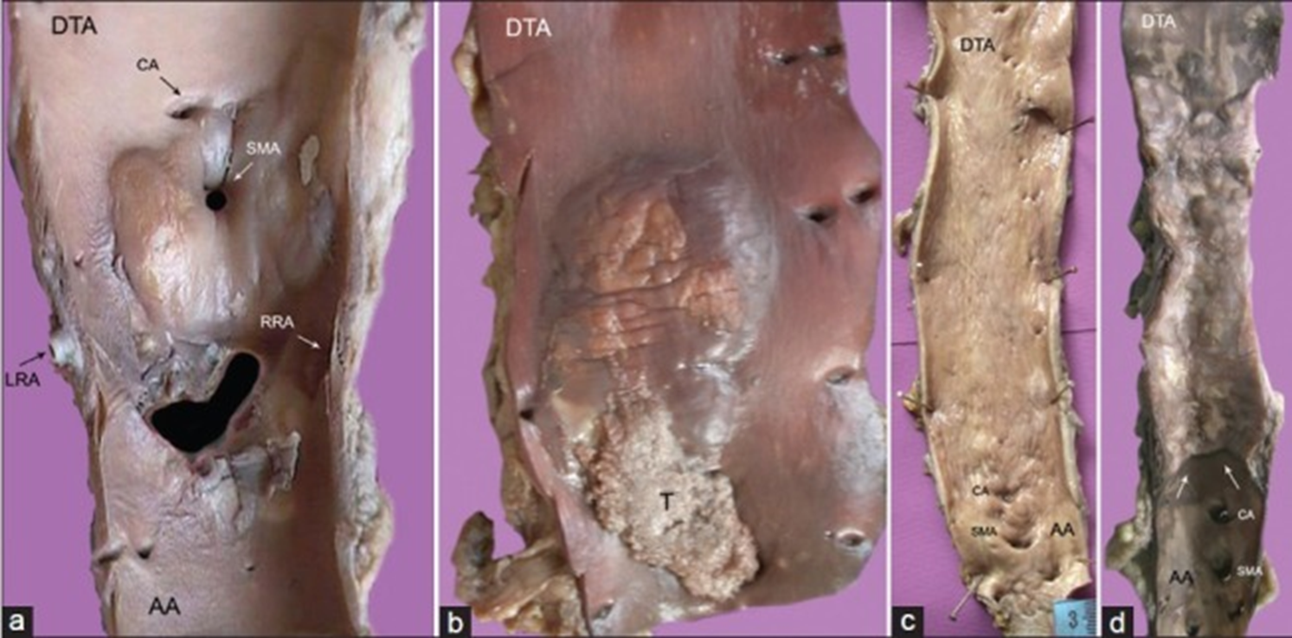
(c) diffuse intimal thickening with superficial scars and furrows of entire descending aorta; (d) the localized disease affecting the descending thoracic aorta (DTA) is abruptly separated from normal abdominal aorta (AA) by a distinct shelf of intimal thickening

Slide 12
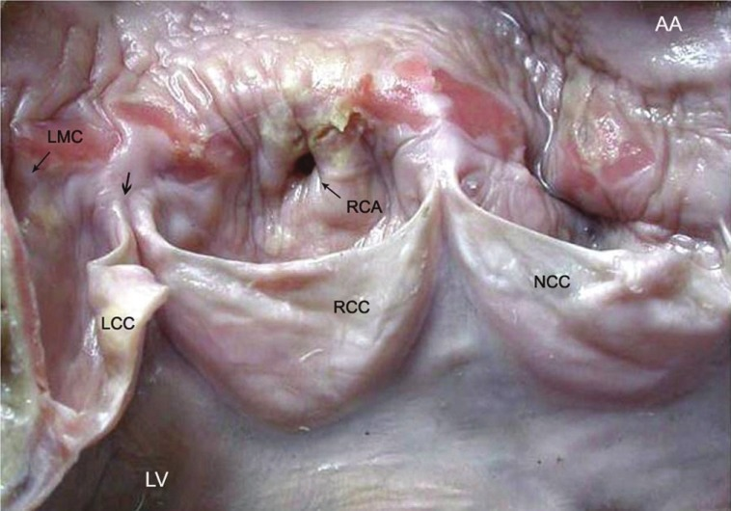
Figure 9
Notes:
A 21-year-old woman, who presented with sudden cardiac death, showed TA manifesting as a band of aortitis affecting the ascending aorta (AA) with narrowing (thin arrow) of the dominant right coronary arterial (RCA) ostium. There is widening of the commissure (thick arrow) between right RCC and left LCC coronary cusps (LV, left ventricle; NCC, non-coronary cusp, LMC, left main coronary ostium)

Slide 13
Aortoarteritis - Pathogenesis
Expression of Heat Shock protein by aortic tissue
Recognized by T4 lymphocytes: triggers secretion of inflammatory cytokines: inflammation/ necrosis/ neovascularization
Further recruitment of B- lymphocytes: anti aortic anti bodies: further inflammatory response

Slide 14
Clinical presentation

Slide 15
TA: Disease progression: 3 stages
The disease progression is said to occur in a tri-phasic pattern
Phase I: The systemic or pre-pulseless phase,
  characterized by constitutional symptoms such as low-grade fever, malaise, night sweats, arthralgia, anorexia, and weight loss.
Phase II: The vasculitis stage
  constitutional symptoms accompanied by features of vascular involvement like tenderness or pain over vessels (angiodynia).
Phase III: The fibrotic, occlusive, quiescent, or “burnt-out” phase:
  features of TA (pulseless disease) related to arterial stenosis or occlusion appear.
Only a minority of patients show such a temporal progression.

Slide 16
TA: Constitutional symptoms
Pre pulseless stage
Constitutional symptoms
Headache (50-70%)
Malaise (35-65%)
Arthralgias (28-75%)
Fever (9-35%)
Weight loss (10-18%)
  High degree of suspicion as no laboratory tests for confirmation)

Slide 17
TA: clinical presentation
TA sooner or later present with symptoms and signs related to vascular stenosis and/or occlusion.
Hypertension :
  with blood pressure differences in the extremities
  pulse deficits,
  bruit, and
  upper and/or lower extremity claudication.
Presentation with heart failure is also common
Neurological, musculoskeletal, and dermatological manifestations are less common.
Around 5% of patients with TA are children and adolescents. Most children are diagnosed between ages 8 and 13 years, and like adults, females outnumber males with a ratio of 3:1.

Slide 18
Takayasu Arteritis:
Cardiovascular manifestations
Cardiac and vascular features
Bruit, with the most common location being the carotid artery (80%)
Blood pressure difference of extremities (45%-69%)
Claudication (38-81%)
Carotodynia or vessel tenderness (13-32%)
Hypertension (28-53%; 58% with renal artery stenosis in one series)
Aortic regurgitation (20-24%)
Raynaud’s syndrome (15%)
Pericarditis (<8%)
Congestive heart failure (<7%)
Myocardial infarction (<3%)

Slide 19
TA: Neuro/ dermatological symptoms
Neurologic features ( vascular ischemia)
Headache (50-70%)
Visual disturbance (16-35%) - Strong association with common carotid and vertebral artery disease
Stroke (5-9%)
Transient ischemic attacks (3-7%)
Seizures (0-20%)
Dermatologic manifestations
Erythema nodosum (6-19%)
Ulcerated subacute nodular lesions (<2.5%)
Pyoderma gangrenosum (<1%)

Slide 20
Takayasu arteritis: Diagnosis

Slide 21
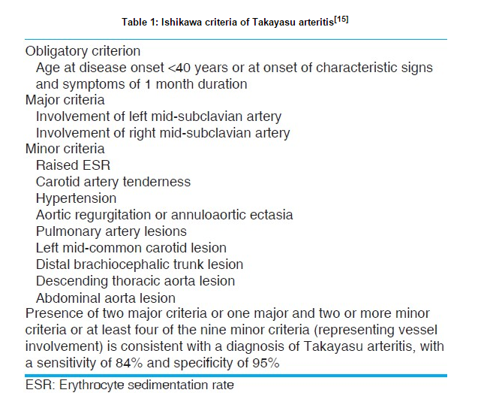
Ishikawa’s criteria - 1988
obligatory
criterion
+
two major criteria
or
one major and two or more minor criteria
or
four more minor criteria
Sensitivity in Indians – 60.4%, specificity - 95%.

Slide 22
Sharma et al: Modification of Ishikawa’s criteria
No obligatory criteria
Major criteria include characteristic symptoms & signs
Inclusion of Infra-renal abdominal aortic lesion
Coronary artery involvement
Sensitivity 92.5% and Specificity 95%

Slide 23
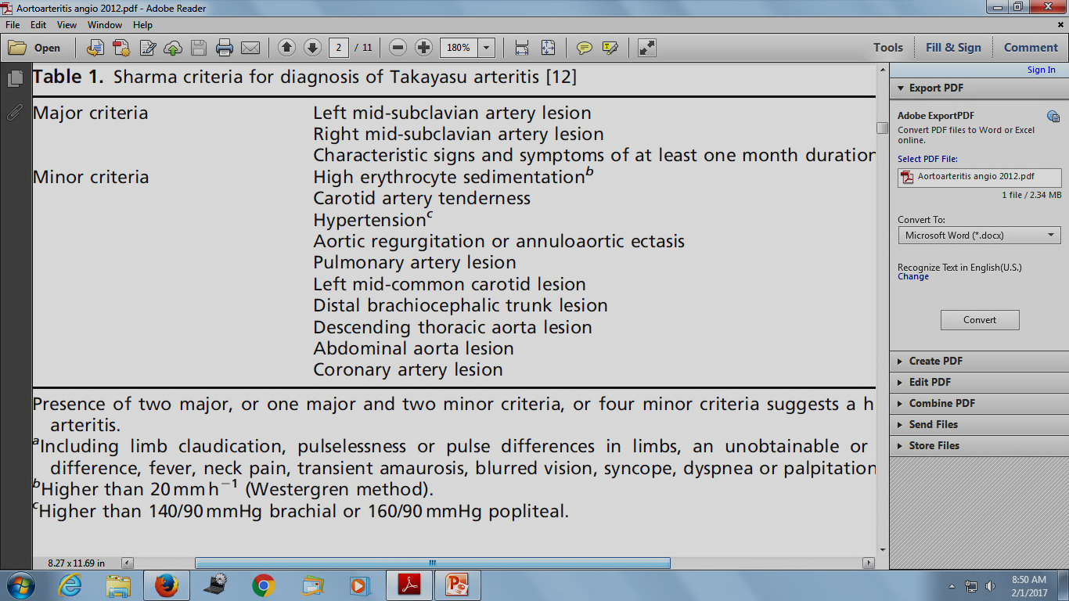

Slide 24
The American College of Rheumatology criteria for Takayasu Arteritis
Age of 40 years or younger at disease onset
Claudication of the extremities
Decreased pulsation of one or both brachial arteries
Difference of at least 10 mm Hg in systolic blood pressure between arms
Bruit over one or both subclavian arteries or the abdominal aorta
Arteriographic narrowing or occlusion of the entire aorta, its primary branches, or large arteries in the upper or lower extremities
(3 of 6 criteria are necessary). The presence of any 3 or more criteria yields a sensitivity of 90.5% and a specificity of 97.8%.

Slide 25
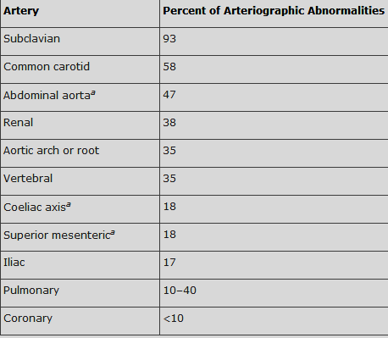
Distribution of arterial lesions

Slide 26
Takayasu Arteritis:
Arterial involvement (contd.)
The infrarenal aorta or the iliac vessels are not usually involved in Takayasu’s arteritis in japan.
The inferior mesentric artery is rarely involved.
Unlike coarctation of the aorta, intercostal collaterals rarely occur as the diffuse intimal disease in the aorta also involves the ostia of these intercostal vessels
Aortic intimal calcification may be seen.
Pseudoaneurysm or dissection of the aorta are extremely rare.

Slide 27
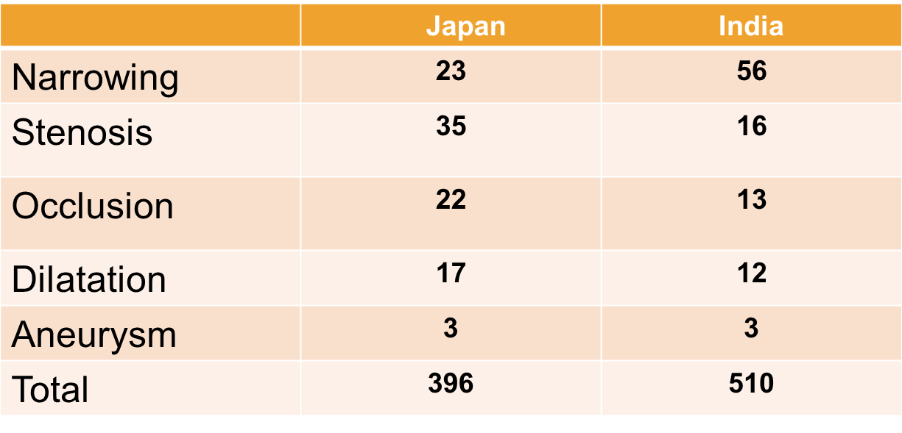
PATTERN OF VESSEL INVOLVEMENT
Narrowing lesions more in Indians, stenosis & subsequent
development of lesions like occlusion, dilatation more in Japanese
Hata, IJC 1996

Slide 28
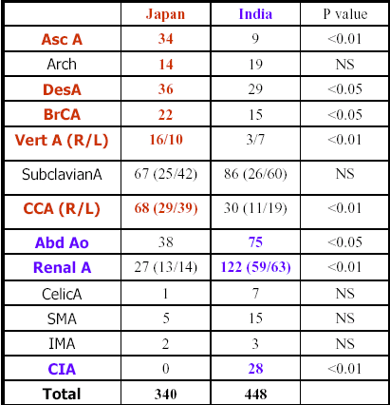
In Japanese, vascular lesions primarily occur in the ascending aorta, aortic arch and /or its branches and extend into the abdominal aorta
Indians – primarily in abdominal aorta & renal artery and extend into thoracic aorta
Angiographic findings of Takayasu arteritis: new classification.
Hata, IJC 1996

Slide 29
TA: Angiographic classification
TA into six types:
Type I: Aortic arch and its branches;
Type II a: Ascending aorta, arch, and its branches;
Type II b: Ascending aorta, arch, and its branches, and descending thoracic aorta
Type III: Thoracic aorta and abdominal aorta
Type IV: Abdominal aorta
Type V: combination of Type II b and Type IV.
  Involvement of coronary arteries is labeled C(+)
  Involvement of pulmonary arteries is denoted as P (+).

Slide 31


TA classification: Ueno et al
Proposed by Ueno et al, modified by Panja et al
  Type I - involvement of aortic arch and its branches (8-16%)
  Type II- Thoraco abdominal aorta, but spares arch (8-11%)
  Type III-Features of I & II (65-76%) (MC in India)
  Type IV-Pulmonary artery involvement (36-45%)
  Type V-Coronary artery involvement (10%)

Slide 32
Imaging in Takaysu arteritis
Invasive
  Conventional Angiography
Non Invasive modality
  High Resolution Ultra sound
  MRA
  CT Angio
  FDG PET scan

Slide 33
Angiography
Considered the gold standard investigation for TA
Accurate assessment of aortic pressure and imaging of the coronary arteries
Luminography - May show a normal angiogram in the early phase of the disease.
Skip lesions” (stenosis or aneurysms alternating with segments of uninvolved blood vessel)
Exposure to contrast media and radioactivity further limits its use as a tool for TA monitoring

Slide 34
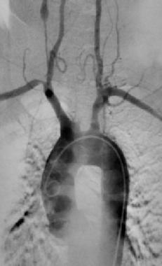
Complete occlusion of the left common carotid artery in a 48-year-old woman with Takayasu disease. Also note narrowing of the origin of the right subclavian artery and a narrowed small vessel with subsequent aneurysmal dilatation on the right side

Slide 35
Artery of Drummond
Notes:
A 10-year-old boy with Takayasu’s arteritis. Flush abdominal aortogram in anteroposterior (A) and lateral (B)
projections shows diffuse significant disease of suprarenal and juxtarenal abdominal aorta with poststenotic dilatation of
infrarenal abdominal aorta. There is also ostial and proximal tight stenosis in the celiac, superior mesenteric, right and left renal
arteries. Also, note the enlarged artery of Drummond supplying collateral circulation from inferior mesenteric artery to superior
mesenteric artery territory.

Slide 36
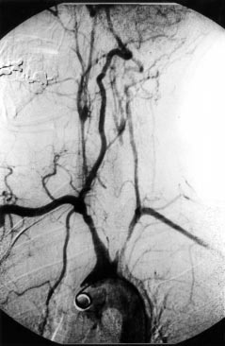
Notes:
Arch aortogram demonstrating (A) a severely narrowed
right common carotid artery, (B) occlusion of the left common carotid
artery and, (C) proximal stenosis of the left subclavian artery.
(D) The right vertebral artery provides the dominant cerebral supply.
482 Johnston, Lock, Gompels
www.jclinpath.

Slide 37
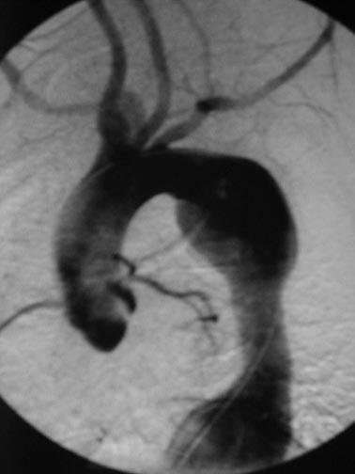

Slide 38
Notes:
Fig. 4.—45-year-old woman with Takayasu’s arteritis.
Oblique projection catheter angiogram shows segmental
stenosis of origin of right upper lobe pulmonary
artery (single arrow). Other stenoses are also visible
(double arrows).

Slide 39
High Resolution Ultra sound
Assess vessel anatomy and luminal status and may demonstrate early vessel wall alterations before detectable lumen changes on angiography
Intima-media complex (IMC) - Increased, diffuse, circumferential intima media thickness in transverse sections (“macaroni sign”) is thought to reflect inflammatory edema, increased vascularity, or both.

Slide 40
High Resolution Ultra sound
Grading response to treatment - Reduction in arterial wall thickness as a response to treatment
Park et al suggested that a common carotid arterial wall thickness of 2.5 to 5.0 mm was a mark of active lesions, compared to 1.1 to 2.0 mm in inactive lesions
  Operator dependent, Common Carotid branches and vertebral artery well visualized.
  Proximal subclavian, distal internal carotid & descending thoracic aorta not well seen.

Slide 41
Notes:
Ultrasound - Doppler ultrasound (ultrasound scan): uses a probe
which is passed over the carotid arteries in the neck. This allows assessment of blood flow and can
detect and monitor the arterial wall and the degree of narrowing.
This illustration shows a normal carotid artery and one from a TA patient. The arrows show the
thickening of the artery wall causing the narrowing of the artery.

Slide 42
Longitudinal B mode sonogram of left mid-carotid artery shows markedly increased intimomedial thickness
(between calipers) and narrowed lumen.

Slide 43
MRI in Takayasu arteritis
Diagnosis
Response to treatment & disease Activity
Advantages :
  Non invasive, no ionizing radiation
  Identification of early phase of disease: edema/ inflammation
  Good delineation of the luminal narrowing and wall thickness
Limitations
  Small vessels cannot be delineated
  Vascular calcifications cannot be seen well
  Some degree of overestimation of vascular stenosis

Slide 44
MRI in Aortoarteritis
During the active phase of the disease, T1weighted images typically show thickened arterial walls.
T 2 weighted images may show increased
mural signal intensity, reflecting tissue edema,
Contrast enhancement of vessel walls suggests increased vascularity in active lesions.
LGE can quantify fibrosis

Slide 45
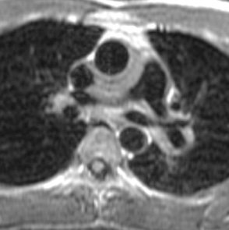
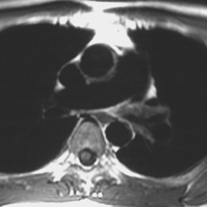
23-year-old man with Takayasu's arteritis in acute phase. Axial T1-weighted image (TR/TE, 857/20) shows wall thickening of ascending aorta and pulmonary artery.
23-year-old man with Takayasu's arteritis in acute phase. Axial T1-weighted image (TR/TE, 800/14) shows improvement of wall thickening of ascending aorta and pulmonary artery after steroid therapy.

Slide 46
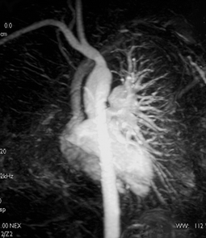
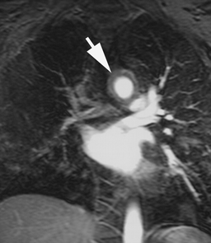
30-year-old woman with Takayasu's arteritis in acute phase. Contrast-enhanced 3D MR angiography shows complete occlusion of right pulmonary, left common carotid, and left subclavian arteries
30-year-old woman with Takayasu's arteritis in acute phase. Early source image of 3D MR angiography shows wall thickening of aortic arch (arrow).

Slide 47
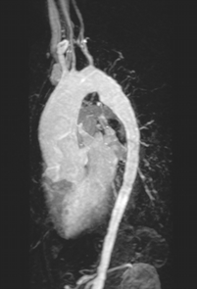
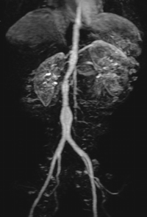
53-year-old woman with Takayasu's arteritis in late phase. Contrast-enhanced 3D MR angiography shows dilatation of ascending aorta. Diffuse narrowing of descending thoracic aorta is also seen.
53-year-old woman with Takayasu's arteritis in late phase. Contrast-enhanced 3D MR angiography shows diffuse narrowing of abdominal aorta. These findings are typical features of aorta in late phase of Takayasu's arteritis.

Slide 48
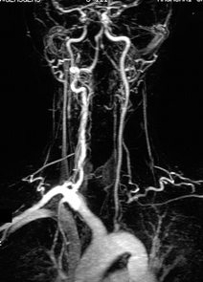
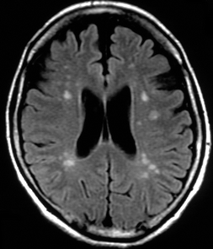
41-year-old woman with Takayasu's arteritis in late phase. Contrast-enhanced 3D MR angiography shows occlusion of left subclavian artery. Irregularities of vessel lumen of other aortic branches are also shown.
41-year-old woman with Takayasu's arteritis in late phase. FLAIR images of show brain atrophy caused by chronic ischemia because of occlusion and stenoses of aortic branches. High signal spots are seen in deep white matter, suggesting small infarctions

Slide 49
CT Angio
CT angio ideal for delineating stenosis, aneurysms
Coronary CT angiography allows the assessment of coronary artery involvement in TA, because most coronary artery lesions in TA are located in ostial or proximal coronary artery.
Limitation :
  Needs iodinated contrast
  Ionizing radiation
  Contraindicated in pregnancy
  Not apt for follow-up

Slide 50
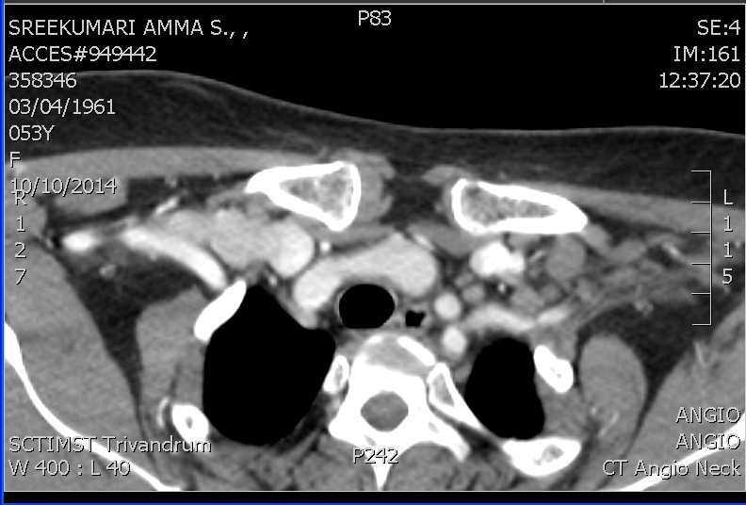
CT Angio for Aorta and UL Vessels

Slide 51
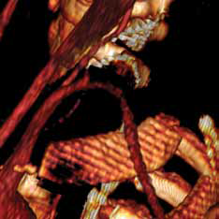
Notes:
Three-dimensional reconstruction
of computed tomography angiography (CTA)
data demonstrating high-grade stenosis in
the left subclavian artery

Slide 52
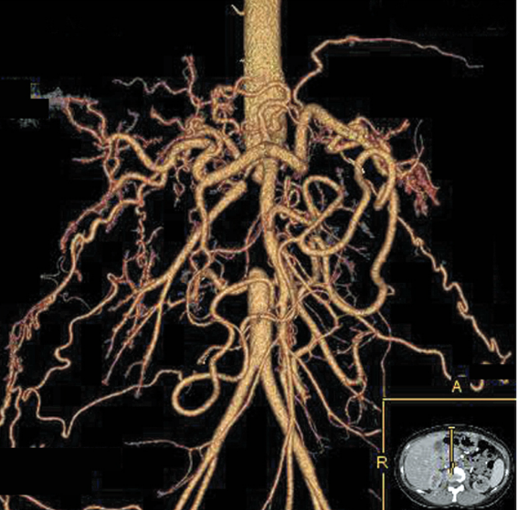
Notes:
A previously healthy 36-year-old Japanese woman presented with blood pressure that was difficult to control after she had undergone an emergency cesarean section at 29 weeks of gestation because of severe hypertension and fetal growth restriction. During pregnancy, her blood pressure had been more than 180/100 mm Hg, and it continued to be more than 160/90 mm Hg after delivery. The patient began taking 40 mg of nifedipine, and the blood pressure level stabilized at approximately 140/80 mm Hg. Computed tomographic (CT) imaging revealed a completely disrupted abdominal aorta, severe stenosis of the renal arteries bilaterally, and development of numerous collateral arteries (the inset shows the axial view, and the yellow line indicates the viewing angle of the main image, which is a three-dimensional reconstruction of the abdominal aorta from enhanced CT slices; A denotes anterior, and R right). A diagnosis of Takayasu’s arteritis was made, and renal-artery stenosis was presumed to be causing secondary hypertension. The patient began receiving immunosuppressive therapy with prednisolone and infliximab, and over the next 2 months the blood pressure gradually decreased to below 130/70 mm Hg. The dose of nifedipine was reduced to 20 mg, and her blood pressure has stabilized at approximately 125/70 mm Hg. Takayasu’s arteritis, also known as pulseless disease, is a form of vasculitis that chiefly affects the aorta and its major branches in young Asian women. Vascular stenosis may progress silently, owing to the development of collateral circulation.

Slide 53
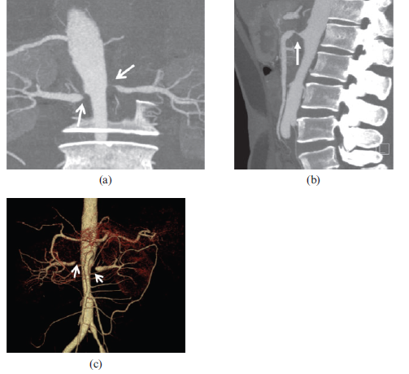
Notes:
Figure 6. A 41-year-old female
patient diagnosed with Takayasu
arteritis with a complaint of hypertension
for 1 year. (a, b) Bilateral
renal (open arrows) and superior
mesenteric arteries (arrow) stenosis
are seen on the maximum intensity
projection images. (c) Volume-rendered
reformatted image shows the
stenotic lesion at the origin of
bilateral renal arteries (open
arrows).

Slide 54
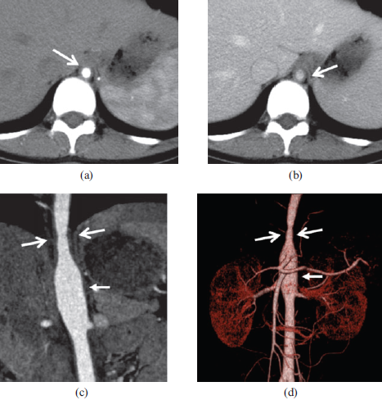
Notes:
Figure 8. A 28-year-old female with
Takayasu arteritis. A concentric narrowing
lesion (open arrows) at the
level of diaphragmatic aortic hiatus
is depicted in (a, b) axial, (c) curved
planar reformatted and (d) volumerendered
images, with the distal
segment mildly dilated [arrows in
(c, d)].

Slide 55
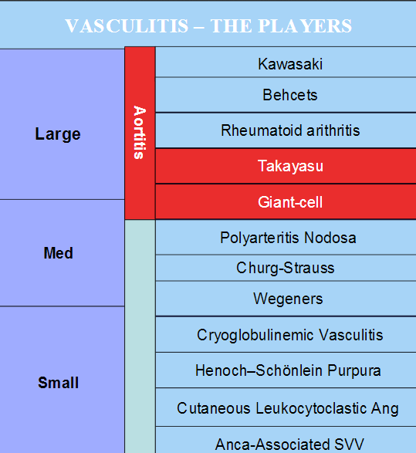

Slide 56
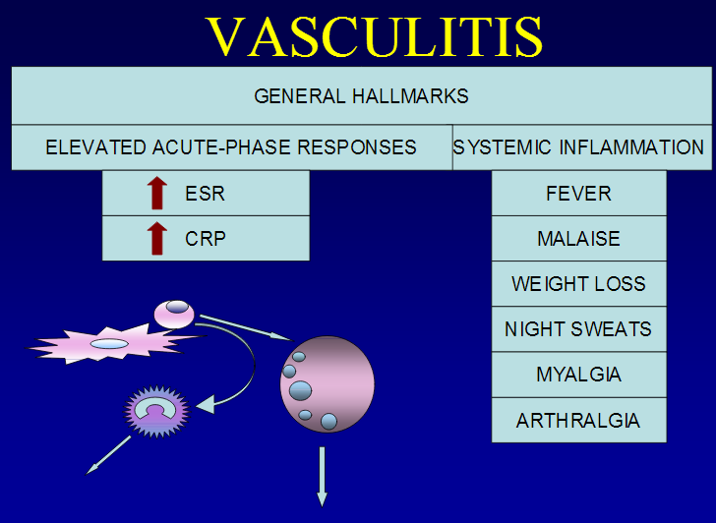

Slide 57
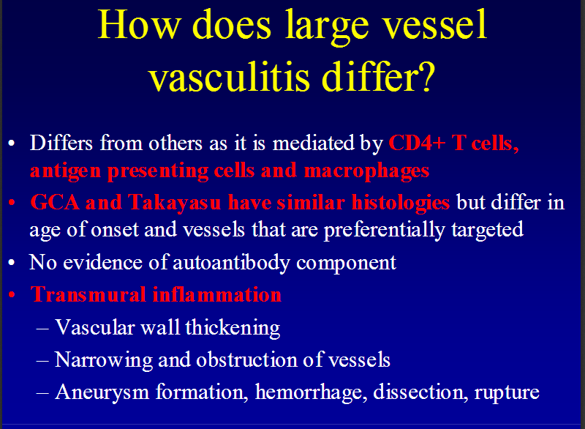

Slide 58
Differential Diagnosis
Aortic Coarctation
Atherosclerosis
Behcet Disease
Giant Cell Arteritis (Temporal Arteritis)
Granulomatosis with Polyangiitis (Wegener Granulomatosis)
IgG4-related disease
Kawasaki Disease
Rheumatoid Arthritis
Sarcoidosis
Systemic Lupus Erythematosus (SLE)
Thromboangiitis Obliterans (Buerger Disease)

Slide 59
Aortoarteritis vs Coarctation
Aortoarteritis
Coarctation
Age, gender: 2nd/ 3rd decade, female
Constitutional symptoms
Carotodinia
Claudication of arms/ legs
TIA/ amaurosis fugax
Angina
Infancy/ occasionally present later in life
Absent
Absent
Leg fatigue
Cerebral hemorrhage : Berry aneurysm
Angina rare

Slide 60
Aortoarteritis vs Coarctation
Aortoarteritis
Coarctation
Hypertension: random pulse asymmetry: carotids frequently involved
Reverse coarctation (Type 1 aortoarteritis)
Bruit over great vessels including abdominal vessels
Aortic regurgitation
Aortic aneurysm common
Optic fundus: Ischemic retinopathy: wreath like
No palpable collaterals
Hypertension: typically upper body: carotids not involved
Typical Coarctation
Bruit over coarct segment. collaterals at the back, epigastrium, IMA
Bicuspid aortic valve/ AS
Aortic aneurysm less frequent
Corkscrew artereoles
Palpable collaterals

Slide 61
Aortoarteritis vs Coarctation: Imaging
Aortoarteritis
Coarctation
Aorta and large vessels involved
Aortic wall thickening/ stenosis/dilation/ aneurysm
Calcification of aorta
Intercostals not enlarged as their ostia involved
Primarily post subclavian aorta
Typical post ductal coarct
Calcification rare
Intercostals partake in collateral formation

Slide 62
Disease Activity
The gold standard for the determination of active vasculitis is histopathological examination of the involved arteries
Elevated ESR (ESR >40 mm/hour, Westergren)/ CRP >3mg/dl is considered to be an indicator of active disease.
However, ESR has not been found to be reliable, as 30% of clinically active patients have a normal ESR and 44% of quiescent patients have an elevated ESR

Slide 63
ESR in Takayasu arteritis: limitation
Minor criterion in Ishikawa’s
30% of active disease pts had normal ESR
56% of quiescent patients had high ESR
44% of pts presumed to be in remission had histological evidence of active vasculitis
On follow up, among pts believed to be in remission 61% had new angiographic lesions

Slide 64
Novel Markers
Pentraxin-3 (PTX3), a member of the superfamily of acute - phase proteins
PTX3 plasma levels were shown to be more accurate than erythrocyte sedimentation rate (ESR) and CRP for differentiating active from inactive disease in 57 patients with previously diagnosed Takayasu arteritis.
PTX3 levels greater than 1 ng/mL were more accurate than normal thresholds of CRP and ESR for defining disease activity.
Other markers of activity - Interlukin 6, MMP 6, Serum Amyloid A, RANTES(attractant for memory T cells), C4 Binding proteins
Notes:
RANTES: A cytokine that is a member of the interleukin-8 superfamily of cytokines. RANTES is a protein. It is a selective attractant for memory T lymphocytes and monocytes. It binds to CCR5, a coreceptor of HIV. RANTES is an acronym for Regulated on Activation, Normal T Expressed and Secreted. It is also known as CCL5.

Slide 65
NIH (Kerr et al ) Criteria for disease activity
The National Institutes of Health (NIH) have arbitrarily defined active disease as new onset or worsening of at least two of the following four features:
  Signs and symptoms of vascular inflammation or ischemia (claudication, decreased or absent pulses or blood pressure in the extremities, bruits or carotidynia)
  Elevated ESR;
  Angiographic abnormalities
  Systemic symptoms not attributable to another disease, e.g. fever, polyarthralgia, polymyalgias.
In 50% of their patients, clinical parameters and nonspecific acute-phase reactants were inadequate measures of disease activity and therefore not reliable enough for therapeutic decisions

Slide 66
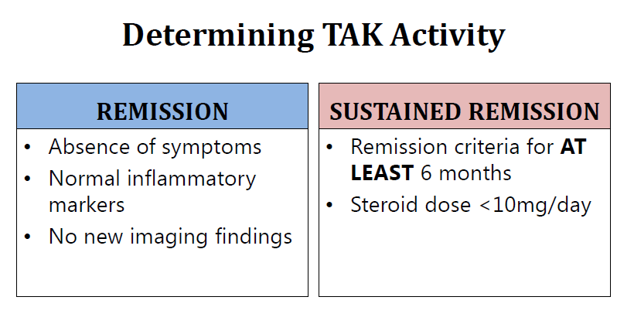

Slide 67
FDG PET
Functional imaging modality, which shows areas of increased metabolic activity
FDG uptake is a useful imaging modality to detect inflammation
18F-FDG uptake was associated with clinical disease activity and markers of inflammation, and FDGPET reflected changes in clinical disease activity
Negative PET does not exclude the disease
Disease activity - Sensitivity of 78% and a specificity of 87%
  Limitations : Associated with radiation exposure, expensive, is limited to relatively few centers, and has low spatial resolution, not allowing the evaluation of vessels < 5 mm.

Slide 68
The illustration shows two PET images from the same patient;
the one on the left is before treatment, with the arrows pointing to
areas of inflammation. These areas have disappeared in the image
on the right which was taken after six months treatment.
Notes:
Positron emission tomography (PET scanning): requires the patient to be injected with
radioactive fluorodeoxyglucose. PET scans are particularly good at detecting inflammation in the
arterial wall and are often used in combination with CT scanning (CT-PET). PET may identify early
active disease and may on occasion help to distinguish active disease (which needs further
treatment) from scarring resulting from previous inflammation. The illustration shows two PET
images from the same patient; the one on the left is before treatment, with the arrows pointing to
areas of inflammation. These areas have disappeared in the image on the right which was taken
after six months treatment.

Slide 69
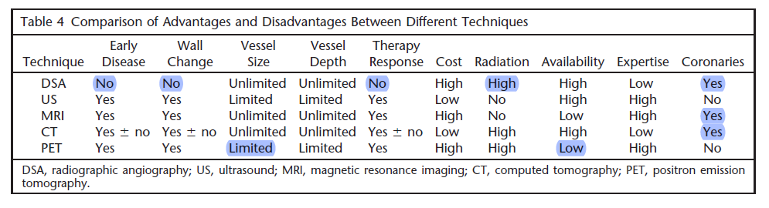

Slide 70
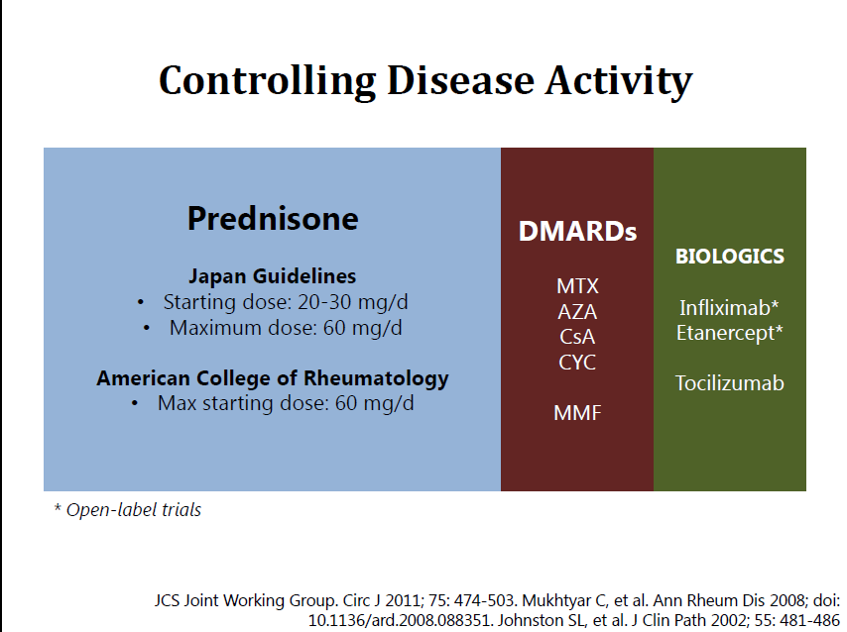
Medical Management

Slide 71
Steroids
Prednisolone 1mg/kg/d (max 60mg) for 1-3mo, tapered to alternate day schedule over next 4-8wks if still inactive, stopped over 6-12 months
Hoffman et al defined ‘Glucocorticoid resistant disease’ as inability to get remission when prednisolone is used at a dose of 1mg/kg/day for 1 month or taper the glucocorticoid treatment within 5 months of therapy
Generally, 50% of pts are steroid responsive, 50% of pts relapsing / not responding to steroids respond to MTX

Slide 72
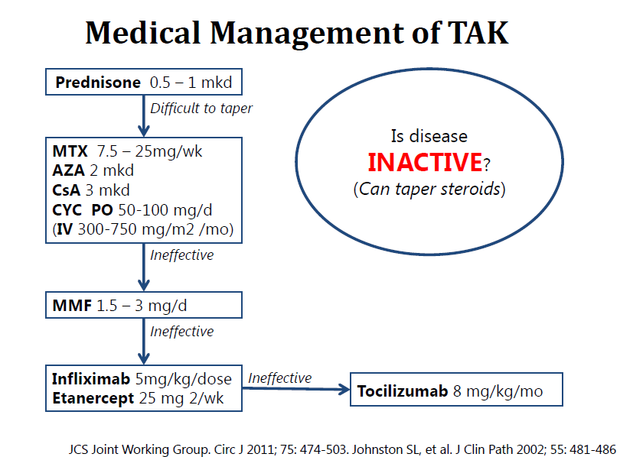
Cisplatin
Mycofenolate Mofetil
Notes:
Mycofenolate Mofetil

Slide 73
A consensus definition of refractory disease
“Angiographic or clinical progression despite treatment” or any of the following characteristics:
1. Corticosteroid dose of >7.5 mg/day after 6 months of treatment
2. Activity despite the administration of conventional immuno-suppressants (methotrexate, azathioprine, leflunomide, or cyclophosphamide),
3. New surgery on account of persistent disease activity,
4. Frequent attacks (>3/year), or mortality associated with disease activity

Slide 74
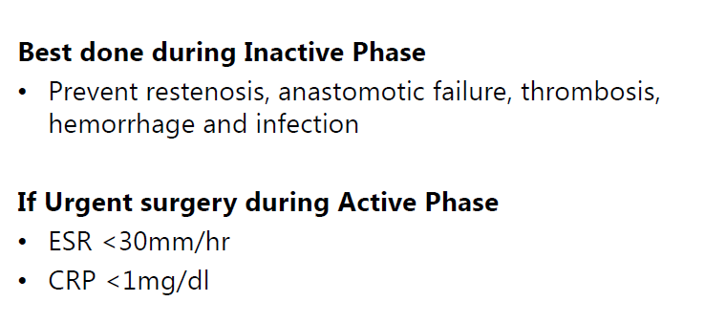
Interventions

Slide 75
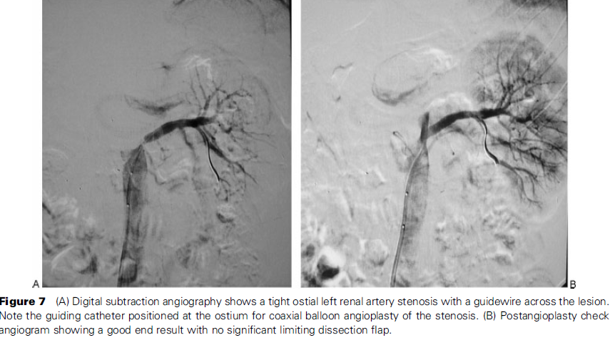

Slide 76
Carotid artery Intervention
Control angio-CT of the patient performed 7 months after procedure. A – 3D reconstruction showing all stents’ patency and no new stenotic lesions of treated vessels. B – 2D cross-section demonstrating undamaged right CCA (white arrow) and RSA (grey arrow) stents’ structure
Notes:
A 33-year-old severely symptomatic female
patient with Takayasu arteritis: A – catheter
angiography showing subtotal right CCA (white
arrows) and LSA (black arrow) stenosis, B – a network
of collateral circulation vessels, contrast infusion
at top of LSA stump, tip of catheter marked
with arrow, C – right CCA inflations using 5.0 ×
60 mm drug-eluting balloon, D – right CCA dissection
(arrow), E – implantation of 8.0 × 40 mm (and
9.0 × 30 mm – not shown) self-expanding stent
in right CCA, basket of distal protection device
marked with arrow, F – postdilatation of stents
with 5.0 × 20 mm balloon, G – drug-eluting 4.0 ×
23 mm stent positioning in RSA ostium (T-stenting),
H – final angiography showing optimal vessel
dilation, I – right hemisphere filling from right vertebral
and carotid arteries with partial left hemisphere
filling via Willis circle

Slide 77
Coronary artery involvement in TA
10 – 30% of patients
  70% with ostial left main coronary involvement
Acute inflammation and the related edema may be important, case reports where regression of an left main stem stenosis was reported with administration of steroids

Slide 78
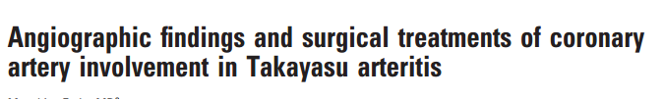
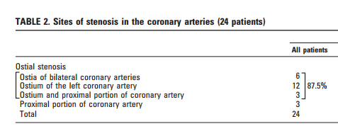

Slide 79
PCI in Takayasu arteritis
For poor surgical candidates or patients who prefer a nonsurgical treatment, PCI may be offered as revascularization strategy
PCI can also be offered to postpone the need for CABG, or treat the restenosis of bypass graft
Antelmi et al. reported that balloon angioplasty for the coronary lesions in Takayasu's arteritis was limited by the high grade residual stenosis due to the elastic recoil
Although stent implantation has decreased the high grade residual stenosis after balloon angioplasty, high rate restenosis remains a major concern

Slide 80
PCI in Takayasu arteritis: contd.
DES the rate of Restenosis is less when compared with BMS
DES may have a potential therapeutic benefit in TA due to its local anti-inflammatory or immuno-modulatory effect on the coronary lesion
Short term results are good, Long term results are unknown
The longest follow-up period was 4 years and 5 years reported by Lee et al., and both stents had in-stent restenosis

Slide 81
CABG in Takayasu arteritis
Bypass surgery can be performed with low morbidity and mortality with good long-term efficacy.
Surgery be performed during TA's inactive stage.
Occlusion or restenosis after bypass grafting occurs in 8 to 31% of cases after a follow-up period of 3 to 6 years.
The main drawback of the IMA is compromise of the grafts when the disease recurs and involves the origin of the subclavian artery or the brachiocephalic trunk
A lower restenosis rate is observed when vascular operations are performed at inactive/ stable stage, especially when immunosuppressive agents are administered with steroid.
*Subsequent steroid treatment can cause significant regression of coronary stenosis that can result in graft occlusion .

Slide 82
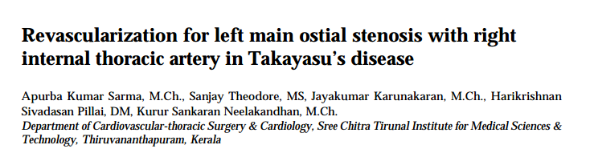
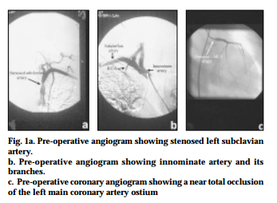
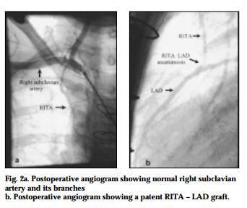

Slide 83
Other Cardiac Manifestations in TA
Coronary artery disease
  Aorto ostial and proximal coronary
Valvular heart disease:
  AR : Aortopathy, hypertension
  Mitral incometence
Pulmonary artery arteritis
  Rare cause of PAH
Dilated cardiomyopathy
  Myocarditis
Pericardial involvement (very rare)

Slide 84
Pulmonary artery involvement
Incidence - 44% (Tyagi et al 28 %, Panja et al 36%)
PA involvement more common in patients of Asian origin
PA involvement generally coexists with aortic and other large artery involvement
PAH in Takayasu Arteritis :
  Pulmonary arterial involvement
  Left ventricular failure
  Combined pulmonary arterial and left ventricular origin
Right upper lobe pulmonary artery branches – More common
Patients with PAH due to Pulmonary artery involvement have a poor prognosis and higher rates of death

Slide 85
Valvular Heart disease
Aortic regurgitation has been reported in 24%
  Aortic dilatation with separation of the cusps is the predominant cause of aortic regurgitation,
  Acute AR due to severe Systemic hypertension has also been reported
  Thickening and puckering of aortic valve leaflets
Mitral regurgitation has been reported in 11.4%

Slide 86
Dilated cardiomyopathy:
Primary myocarditis
Incidence - 5 %
Male = female, Younger age at presentation
  Commonly due to coronary artery involvement
  Aortic regurgitation
  Histopathological study (on 3 autopsy cases) showed nonspecific inflammation of myocardium with lymphocyte/ mononuclear cell infiltration and normal coronary vessels
Rare as an initial manifestation of the disease

Slide 87
Cardiac failure
The cause of heart failure in TA patients is multifactorial and includes
  Hypertension,
  Aortic valve regurgitation
  Coronary artery disease
  Myocarditis
  Pulmonary hypertension due to PA involvement

Slide 88
Aortic dissection
Aortic dissection is distinctly rare
Only a limited number of surgically treated cases of Takayasu's arteritis, which was complicated by aortic dissection, reported.
Takayasu's arteritis is more frequently complicated by aortic dissection localized in the descending or abdominal aorta (Stanford type B) than by aortic dissection localized in the ascending aorta (Stanford type A).

Slide 89
Takayasu Arteritis and pregnancy
Abdominal aortic and renal involvement
Hypertension
Complications of pre-eclampsia / HF
Renal failure
Disease exacerbation by pregnancy (rare)
Limited experience: Pregnancy can be undertaken safely with adequate BP control, shorten 2nd stage of labor

Slide 90
Conclusion
Takayasu arteritis is rare, affects mainly women, and is most commonly seen in Japan, South East Asia, India, and Mexico, where it usually presents in the 2nd or 3rd decade of life
Manifestations range from asymptomatic disease, found as a result of impalpable pulses or bruits, to catastrophic neurological impairment
Invasive angiography/ MRI are the gold standard for diagnosis

Slide 91
Conclusion: Contd.
Approximately half of those patients treated with steroids will respond, and half of the remaining patients respond to methotrexate; mycophenolate mofetil may be useful
Treatment should aim to control disease activity and preserve vascular competence, with minimal long term side effects;
Fertility is not adversely affected and pregnancy does not appear to exacerbate the disease, although management of hypertension is essential

Slide 92
Thank You

